Slide 1


Learning Sentiment-Specific Word Embedding for Twitter Sentiment Classification
Duyu Tang, Furu Wei, Nan Yang, Ming Zhou, Ting Liu, Bing Qin
Harbin Institute of Technology
Microsoft Research
ACL 2014
日期：2015/01/09

Slide 2
Outline
Introduction
Sentiment-Specific Word Embedding
-C & W Model
- SSWE Model
Experiments
-Twitter Sentiment Classification
-Word Similarity of Sentiment Lexicons
Conclusion

Slide 3
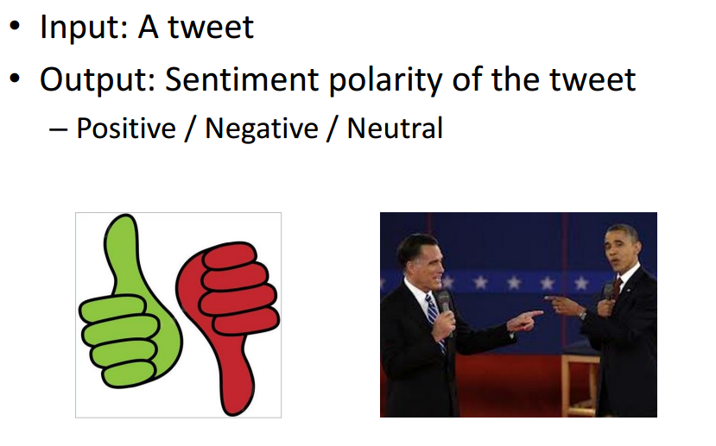
Introduction:
Twitter sentiment classification has attracted increasing research interest in recent years.
The objective is to classify the sentiment polarity of a tweet as positive, negative or neutral.

Slide 4
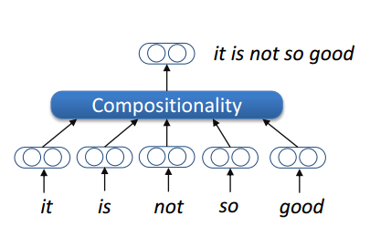
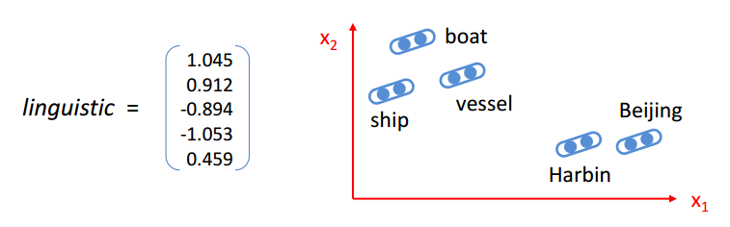
For the task of sentiment classification, an effective feature learning method is to compose the representation of a sentence from the representations of the words or phrases it contains.
Accordingly, it is a crucial step to learn the word representation (or word embedding), which is a dense, low-dimensional and real-valued vector for a word.
Although existing word embedding learning algorithms are intuitive choices, they are not effective enough if directly used for sentiment classification.

Slide 5
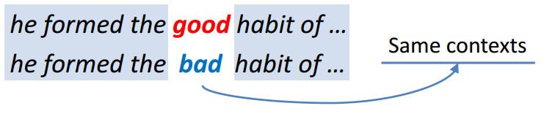
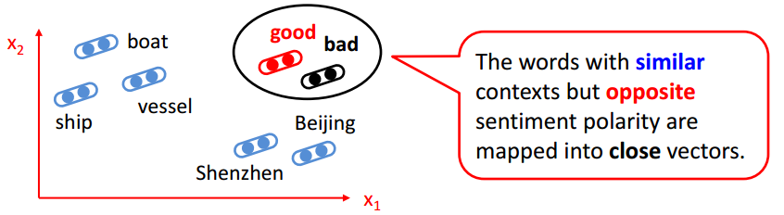
Most existing algorithms for learning continuous word representations typically only model the syntactic context of words but ignore the sentiment of text.
This is problematic for sentiment analysis as they usually map words with similar syntactic context but opposite sentiment polarity, such as good and bad, to neighboring word vectors.

Slide 6
In this paper, we propose learning sentiment specific word embedding (SSWE) for sentiment analysis.
We encode the sentiment information into the continuous representation of words, so that it is able to separate good and bad to opposite ends of the spectrum.
We extend the existing word embedding learning algorithm and develop three neural networks to effectively incorporate the supervision from sentiment polarity of text in their loss functions.
We learn the sentiment-specific word embedding from tweets, leveraging massive tweets with emoticons as distant-supervised corpora without any manual annotations.
(Distant-supervised: Leverage massive noisy-labeled tweets selected by positive and negative emoticons as training set and build sentiment classifiers directly)

Slide 7
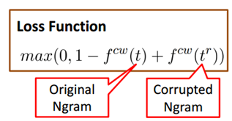



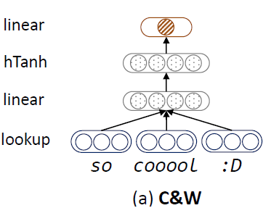
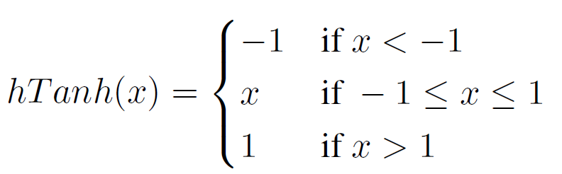
C & W Model (Collobert et al.,2011)
Collobert et al. (2011) introduce C&W model to learn word embedding based on the syntactic contexts of words.
Lm score
Lookup table of word embedding w_{1.}

Slide 8
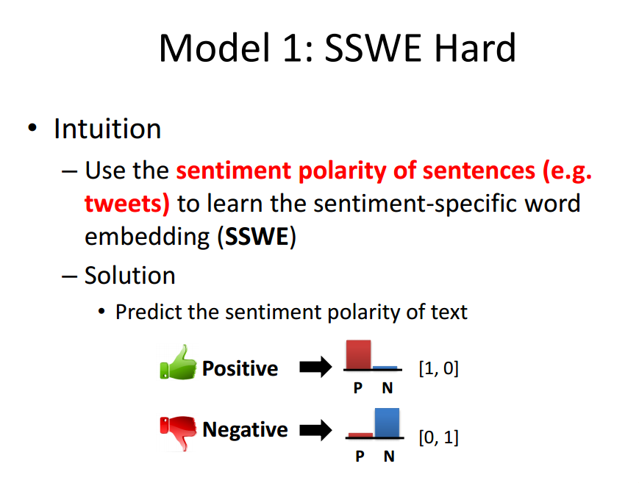
Sentiment-Specific Word Embedding (SSWE)

Slide 9


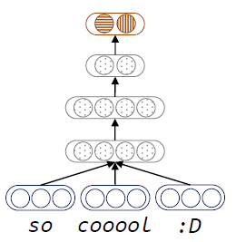

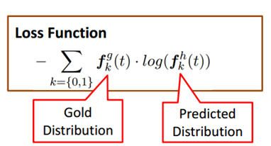
Basic Model 1 (SSWE_{h}):
We utilize the continuous vector of top layer to predict the sentiment distribution of text.
Assuming there are K labels, we modify the dimension of top layer in C&W model as K and add a softmax layer upon the top layer.
Softmax layer is suitable for this scenario because its outputs are interpreted as conditional probabilities.

Slide 10
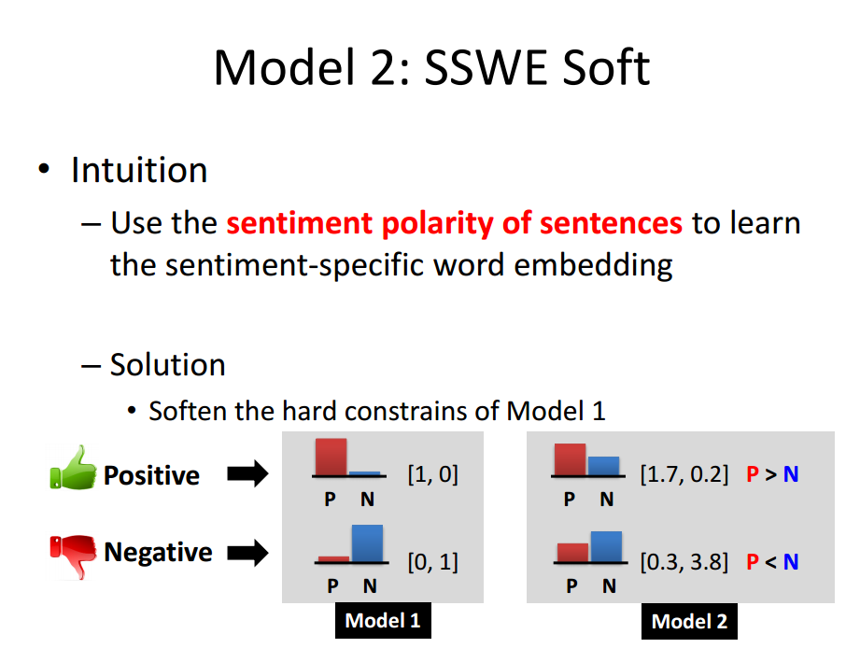

Slide 11

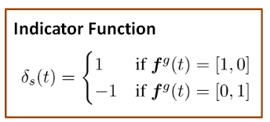
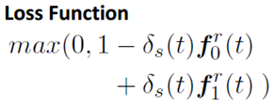
Basic Model 2 (SSWE_{r}):
The distribution of [0.7,0.3] can also be interpreted as a positive label because the positive score is larger than the negative score.
Compared with SSWE_{h}, the softmax layer is removed because SSWE_{r} does not require probabilistic interpretation.
is an indicator function reflecting the sentiment polarity of a sentence.
Similar with SSWE_{h}, SSWE_{r} also does not generate the corrupted ngram.
Positive Score
Negative Score

Slide 12
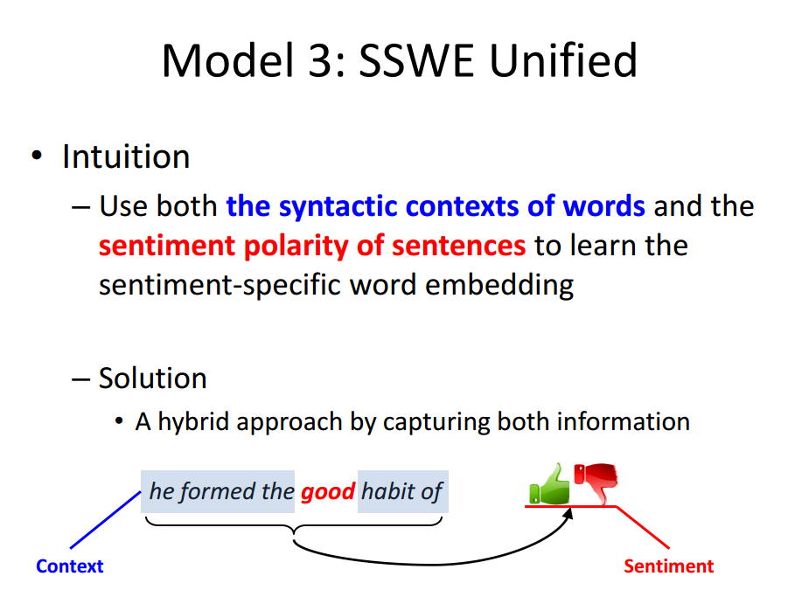

Slide 13

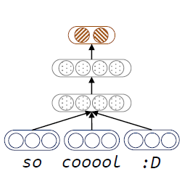

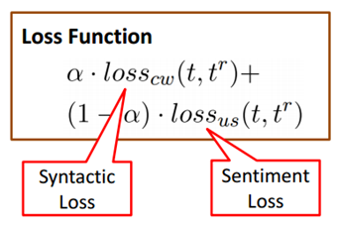
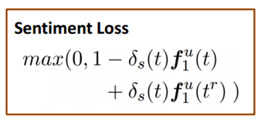
Unified Model (SSWE_{u}):
The C&W model learns word embedding by modeling syntactic contexts of words but ignoring sentiment information.
By contrast, SSWE_{h} and SSWE_{r} learn sentiment-specific word embedding by integrating the sentiment polarity of sentences but leaving out the syntactic contexts of words.
We develop a unified model (SSWE_{u}) in this part, which captures the sentiment information of sentences as well as the syntactic contexts of words.

Slide 14
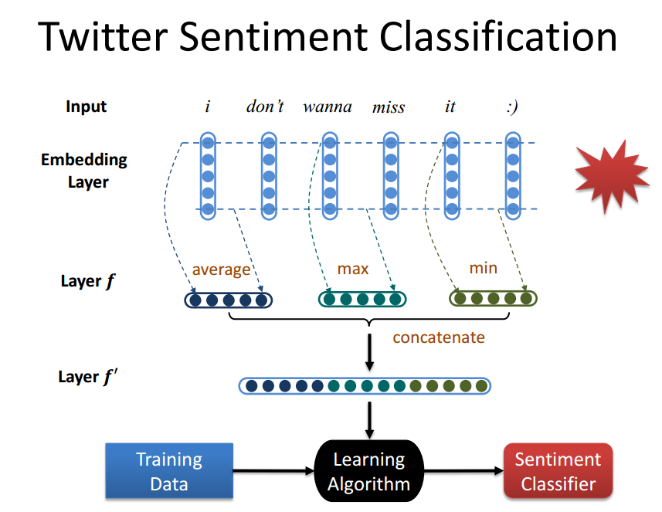

Slide 15
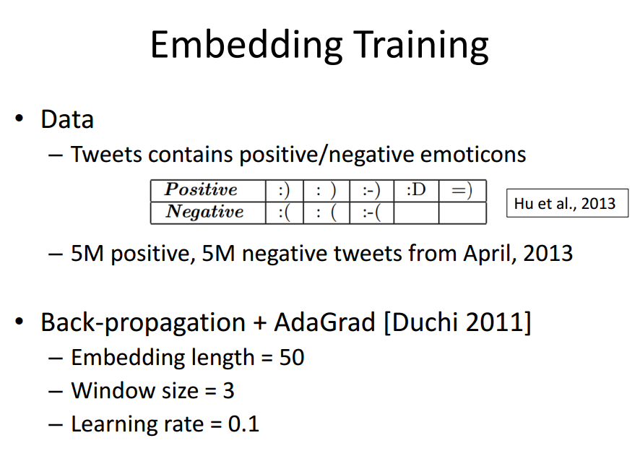
Experiments:

Slide 16
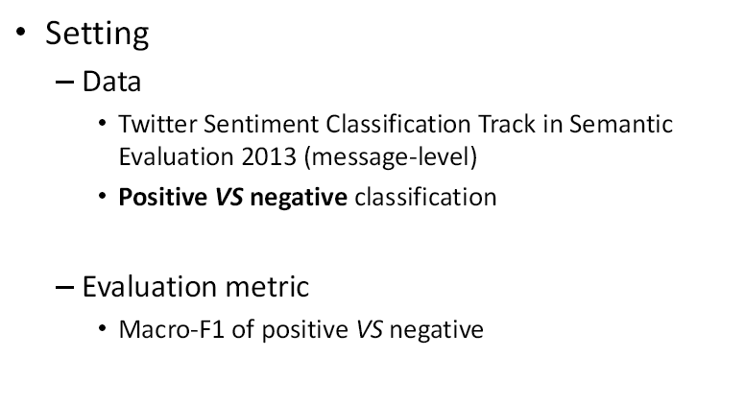
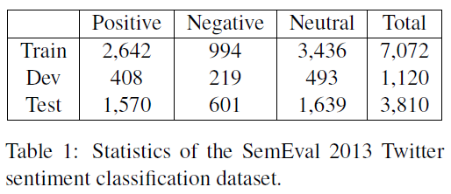
Twitter Sentiment Classification:

Slide 17
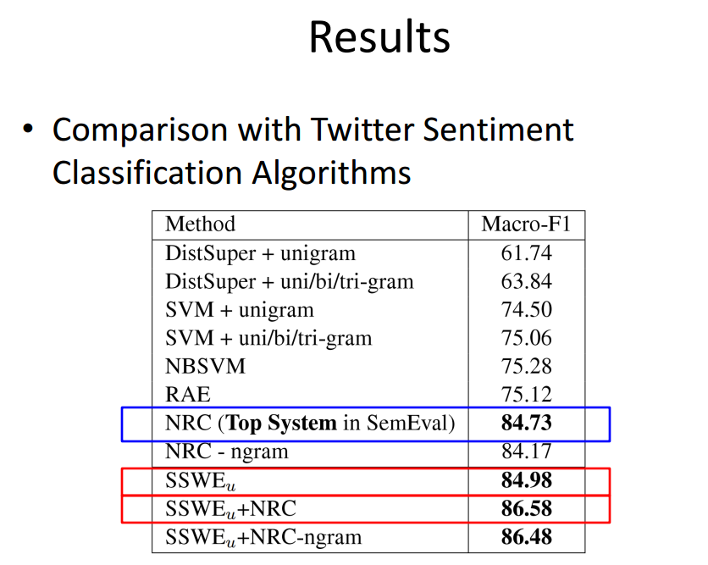

DistSuper: We use the 10 million tweets selected by positive and negative emoticons as training data.
NBSVM: trades-off between Naive Bayes and NB-enhanced SVM.
RAE: Recursive Autoencoder
NRC: NRC builds the top-performed system in SemEval 2013 Twitter sentiment classification track which incorporates diverse sentiment lexicons and many manually designed features.

Slide 18
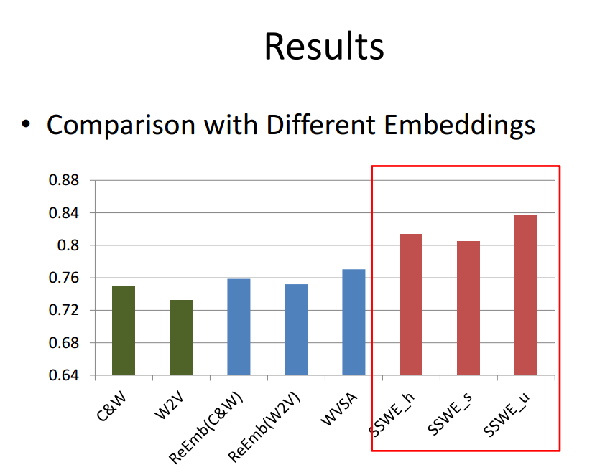


Slide 19
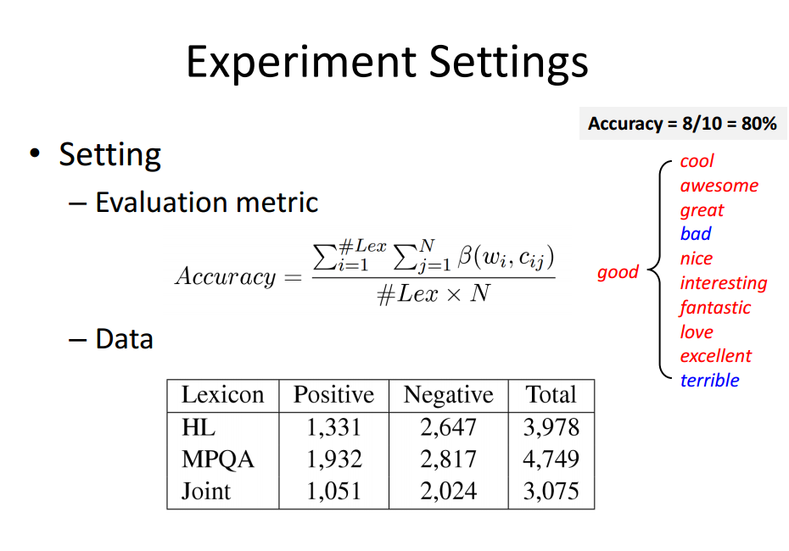

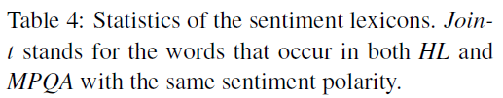

Slide 20
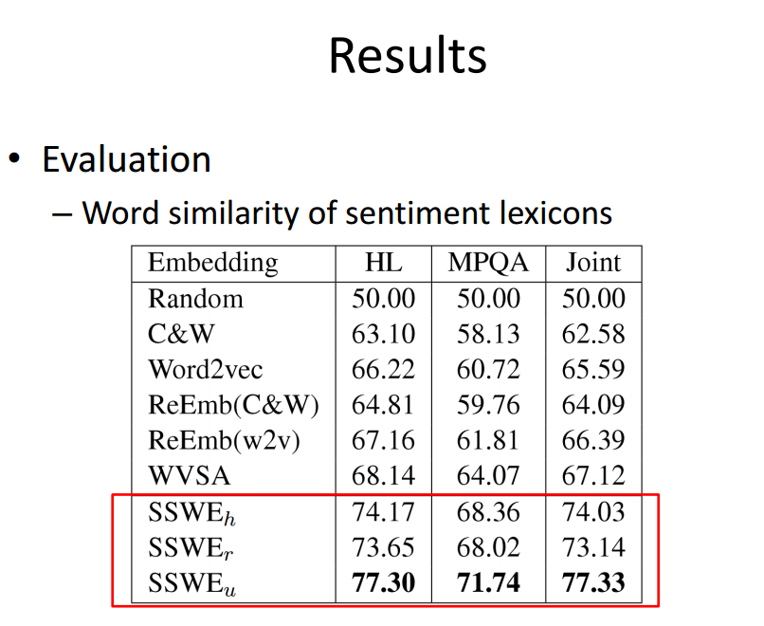


Slide 21
Conclusion:
In this paper, we propose learning continuous word representations as features for Twitter sentiment classification under a supervised learning framework.
We learn sentiment-specific word embedding (SSWE) by integrating the sentiment information into the loss functions of three neural network
The effectiveness of SSWE has been verified in Twitter sentiment classification and word similarity judgments.

